Slide 1
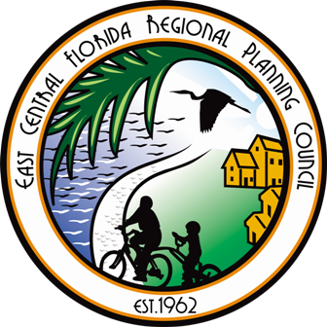
Resilience Action Plan Sub Committee Conference Call SLR projections
March 29, 2018

Slide 2
Agenda
Welcome and Roll Call
SLR Recommendation Review
Documents
Next Steps
Open Discussion and Questions

Slide 3
Sea Level Rise projections Recommendation review

Slide 5
Summary
The sea level rise projection subcommittee associated with the East Central Florida Regional Resilience Action Plan provides the following recommendation for the east central Florida region for planning for sea level rise:
No one projection rate curve should be used for planning purposes. Instead, a range of rise should be considered based upon the vulnerability, allowable risk, and operational life span of a facility or development. The range should include a minimum rise of feet 5.15 by 2100 (associated with the 2013 USACE High) with an upper range of 8.5 feet by 2100 (2017 NOAA High). Short term planning should consider 2040 (20 year planning horizon), 2070 as medium term planning (50 year planning horizon) and 2100 as long term planning (80 year planning horizon).

Slide 6
Upper Bound Description
The sea level rise estimates associated with the NOAA 2017 High rate curve are recommended as the upper bound of the planning scenario. These data are recommended for assessment and adaptation planning of those facilities that have little risk tolerance and long functional life span, and new/proposed development or significant intensification on previously undeveloped or minimally developed land that may be in future fringes of vulnerable areas. The upper range of sea level rise planning should consider the local estimate for the forecasted year of life expectancy of the facility or infrastructure. Based on the regional approach of 2040, 2070 and 2100 planning horizons, facilities requiring a high level of sea level rise planning are recommended to plan for a minimum of 4.5 feet of sea level rise for 2070 and 8.5 feet for 2100.
Lower Bound Description
The recommended minimal or lower bound of planning level for consideration is the USACE 2013 High Rate Curve or a minimum planning of 5.15 feet of rise by 2100 (1.22 ft. by 2040 and 2.85 ft by 2070). This minimal planning level would be recommended for facilities of little significance in terms of the health, safety and welfare of the community, facilities with a short time-frame of functionality or facilities that are easily relocated.

Slide 7
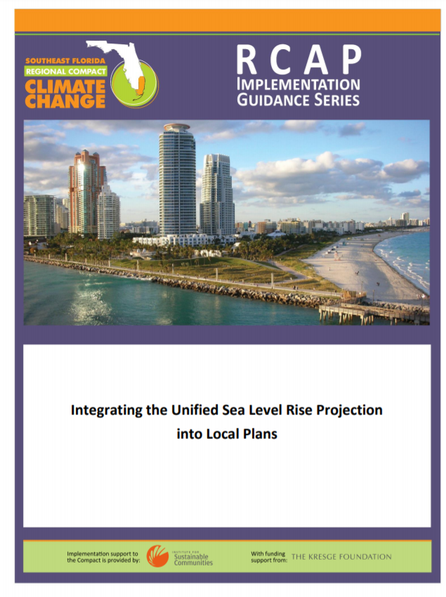
Documents
One-to three pager describing the recommendation range and why, include chart and table.
Provide links to USACE download page and other relevant information including the studies sent after last meeting
Technical Document
Can this be rolled into the above due to links, etc.?
What is the goal?
Guidance document
Include the above and what else?
Use RCAP as example – or -
Not reinvent the wheel?
Future funding? DEO?

Slide 8
Next Steps

Slide 9
Next Steps
Notes/changes from today’s call
Development of draft of recommendation summary by August for team review.
Next Call will be August 31st to go over comments from the recommendation
Unless an “emergency” call is needed

Slide 10
Open Discussion and Questions

Slide 11
Next Steps Next Call – August 31, 10 AM

